Slide 1
Relational Algebra
10

Slide 2
Contents
Introduction to Relational algebra & Relational calculus
Relational Algebra
Its operation

Slide 3
Introduction
We have designed the database, we need to store and retrieve data from the database, for this purpose we need to understand the concept of Relational algebra and Relational calculus.

Slide 4
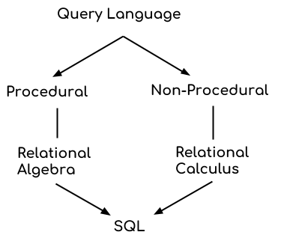
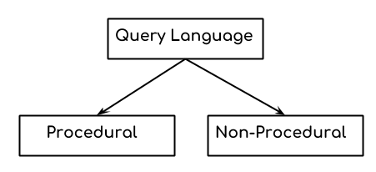
Query Language
In simple words, a Language which is used to store and retrieve data from database is known as query language. For example – SQL
There are two types of query language: 1.Procedural Query language 2.Non-procedural query language

Slide 5
1. Procedural Query language:
In procedural query language, user instructs the system to perform a series of operations to produce the desired results. Here users tells what data to be retrieved from database and how to retrieve it.
For example – Let’s take a real world example to understand the procedural language, you are asking your younger brother to make a cup of tea, if you are just telling him to make a tea and not telling the process then it is a non-procedural language, however if you are telling the step by step process like switch on the stove, boil the water, add milk etc. then it is a procedural language.

Slide 6
2. Non-procedural query language:
In Non-procedural query language, user instructs the system to produce the desired result without telling the step by step process. Here users tells what data to be retrieved from database but doesn’t tell how to retrieve it.

Slide 7
Relational Algebra
Relational algebra is a procedural query language.
It takes relation as input and generate relation as output.
Relational algebra mainly provides theoretical foundation for relational databases and SQL.

Slide 8
Relational Algebra
It uses operators to perform queries.
An operator can be either unary or binary.

Slide 9
Relational Algebra
The fundamental operations of relational algebra are as follows −
Select
Project
Union
Intersection
Set difference
Cartesian product
Rename
Division
Join

Slide 10
Relational Algebra
The relational algebraic operations can be divided into set oriented operations and relational oriented operations.
Set oriented operations include the following:
Union
Intersection
Set difference
Relational oriented operation include the following
Select
Project
Rename
Cartesian Product
Division
Join

Slide 11
Relational Algebra
Fundamental operations | Derived operations
Union | Intersection
Set difference | Division
Cartesian Product | Natural Join
Rename
Select
Project

Slide 12
I. Union operation (υ)
UNION is symbolized by ∪ symbol. It includes all tuples that are in tables A or in B. It also eliminates duplicate tuples. So, set A UNION set B would be expressed as:
The result <- A ∪ B
For a union operation to be valid, the following conditions must hold –
R and S must be the same number of attributes.
Attribute domains need to be compatible.
Duplicate tuples should be automatically removed.

Slide 13
Union-Example
Consider the following tables.
Table A Table B
A ∪ B
Column 1 | Column 2
1 | 1
1 | 2
Column 1 | Column 2
1 | 1
1 | 3
Column 1 | Column 2
1 | 1
1 | 2
1 | 3

Slide 14
Question Time:
Consider two tables R1 and R2 as shown below −
R1 U R2
Table R1
Table R2
Regno | Branch | Section
1 | CSE | A
2 | ECE | B
3 | MECH | B
4 | CIVIL | A
5 | CSE | B
1 | CIVIL | A
2 | CSE | A
3 | ECE | B
Regno | Branch | Section
1 | CSE | A
2 | ECE | B
3 | MECH | B
4 | CIVIL | A
5 | CSE | B
Regno | Branch | Section
1 | CIVIL | A
2 | CSE | A
3 | ECE | B

Slide 15
II. Set Difference
– Symbol denotes it. The result of A – B, is a relation which includes all tuples that are in A but not in B.
The attribute name of A has to match with the attribute name in B.
The two-operand relations A and B should be either compatible or Union compatible.
It should be defined relation consisting of the tuples that are in relation A, but not in B.

Slide 16
Set Difference-Example
Table A
Table B
Column 1 | Column 2
1 | 1
1 | 2
Column 1 | Column 2
1 | 1
1 | 3
Table A-B
Table B-A
Column 1 | Column 2
1 | 2
Column 1 | Column 2
1 | 3

Slide 17
Question Time:
Table R1
Regno | Branch | Section
1 | CSE | A
2 | ECE | B
3 | MECH | B
4 | CIVIL | A
5 | CSE | B
R1 - R2
Regno | Branch | Section
1 | CSE | A
2 | ECE | B
3 | MECH | B
4 | CIVIL | A
5 | CSE | B
R2 – R1
Regno | Branch | Section
1 | CIVIL | A
2 | CSE | A
3 | ECE | B
Table R2
Regno | Branch | Section
1 | CIVIL | A
2 | CSE | A
3 | ECE | B

Slide 18
III. Cartesian Product
Cartesian Product in DBMS is an operation used to merge columns from two relations. Generally, a Cartesian product is never a meaningful operation when it performs alone. However, it becomes meaningful when it is followed by other operations. It is also called Cross Product or Cross Join. Cartesian Product is denoted by X symbol.
Syntax of Cartesian product (X)
R1 X R2

Slide 19
Example-Cartesian product (X)
Table 1: R Table : R X S
Table 2: S
Col. A | Col. B | Col. X | Col. Y
AA | 100 | XX | 99
AA | 100 | YY | 11
AA | 100 | ZZ | 101
BB | 200 | XX | 99
BB | 200 | YY | 11
BB | 200 | ZZ | 101
CC | 300 | XX | 99
CC | 300 | YY | 11
CC | 300 | ZZ | 101
Col. A | Col. B
AA | 100
BB | 200
CC | 300
Col. X | Col. Y
XX | 99
YY | 11
ZZ | 101

Slide 20
Question Time:
RegNo | Branch | Section
1 | CSE | A
2 | ECE | B
3 | CIVIL | A
4 | IT | B
RegNo | Branch | Section | Name | RegNo
1 | CSE | A | Bhanu | 2
1 | CSE | A | Priya | 4
2 | ECE | B | Bhanu | 2
2 | ECE | B | Priya | 4
3 | CIVIL | A | Bhanu | 2
3 | CIVIL | A | Priya | 4
4 | IT | B | Bhanu | 2
4 | IT | B | Priya | 4
R1
R1 X R2
Name | RegNo
Bhanu | 2
Priya | 4
R2

Slide 21
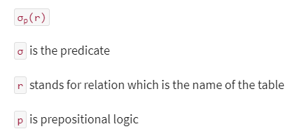
IV. Select
Select Operator is denoted by sigma (σ) and it is used to find the tuples (or rows) in a relation (or table) which satisfy the given condition.
Syntax of Select Operator (σ)
σ Condition/Predicate(Relation/Table name)

Slide 22

Select
Select operation chooses the subset of tuples from the relation that satisfies the given condition mentioned in the syntax of selection. The selection operation is also known as horizontal partitioning since it partitions the table or relation horizontally.
where ‘c’ is selection condition which is a Boolean expression(condition), we can have a single

Slide 23
Select
R is a relational algebra expression, whose result is a relation. The Boolean expression specified in condition ‘c’ can be written in the following form:
<attribute name> <comparison operator> <constant value> or <attribute name>

Slide 24
Select
<comparison operator> is any of the operator {<, >, =, <=, >=, !=} and,
<constant value> is constant value taken from the domain of the relation.
It is a unary operation because its works on one relation.

Slide 25
Select- Example
Table: Customer
σ Customer_City="Agra" (CUSTOMER)
Customer_Id | Customer_Name | Customer_City
C10100 | Steve | Agra
C10111 | Raghu | Agra
C10115 | Chaitanya | Noida
C10117 | Ajeet | Delhi
C10118 | Carl | Delhi
Output:
Query:
Customer_Id | Customer_Name | Customer_City
C10100 | Steve | Agra
C10111 | Raghu | Agra

Slide 26

Question Time:
Select that record whose rating is greater than 8 from S2 table
Sid | sname | rating | age
28 | Yuppy | 9 | 29
58 | rusty | 10 | 38
12 | Keith | 7 | 34
31 | Rose | 9 | 27
44 | guppy | 5 | 55
58 | rusty | 10 | 23
Sid | sname | rating | age
28 | Yuppy | 9 | 29
58 | rusty | 10 | 38
31 | Rose | 9 | 27
58 | rusty | 10 | 23
Table S2

Slide 27
V. Project
This operation shows the list of those attributes that we wish to appear in the result. Rest of the attributes are eliminated from the table.
It is denoted by ∏.
Syntax of Project Operator (∏)
∏ column_name1, column_name2, ...., column_nameN(table_name)

Slide 28
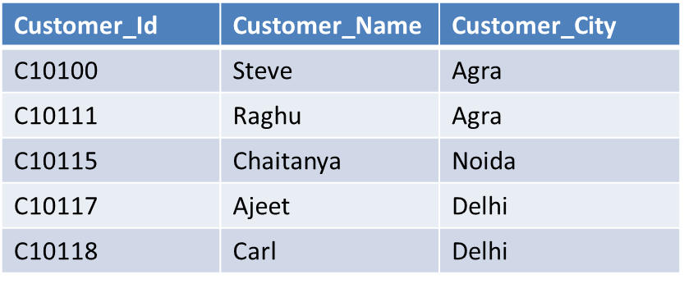
Example-Project Operator (∏)
We have a table CUSTOMER with three columns, we want to fetch only two columns of the table, which we can do with the help of Project Operator ∏.
Output:
Table: Customer
Customer_Name | Customer_City
Steve | Agra
Raghu | Agra
Chaitanya | Noida
Ajeet | Delhi
Carl | Delhi
Query:
∏ Customer_Name, Customer_City (CUSTOMER)

Slide 29

Question Time:
Select sname and rating whose rating is greater than 8 from S2 table
Sid | sname | rating | age
28 | Yuppy | 9 | 29
58 | rusty | 10 | 38
12 | Keith | 7 | 34
31 | Rose | 9 | 27
44 | guppy | 5 | 55
58 | rusty | 10 | 23
sname | rating
Yuppy | 9
rusty | 10
Rose | 9
rusty | 10
Table S2

Slide 30
VI. Rename (ρ)
Rename (ρ) operation can be used to rename a relation or an attribute of a relation.
Rename (ρ)
Syntax: ρ(new_relation_name, old_relation_name)

Slide 31
Rename (ρ)- Example
Lets say we have a table customer, we are fetching customer names and we are renaming the resulted relation to CUST_NAMES.
Customer_Id | Customer_Name | Customer_City
C10100 | Steve | Agra
C10111 | Raghu | Agra
C10115 | Chaitanya | Noida
C10117 | Ajeet | Delhi
C10118 | Carl | Delhi

Slide 32
Rename (ρ)- Example
Query:
ρ(CUST_NAMES, ∏(Customer_Name)(CUSTOMER))
CUST_NAMES
Steve
Raghu
Chaitanya
Ajeet
Carl

Slide 33


